Slide 1

Data Analytics Capstone
CKME136 XJ Winter 2019
BY: Jean-Felix Juste-COnstant

Slide 2

Market Sensory Prediction
Machine Learning algorithms for stock price prediction

Slide 3

Introduction
Stock trading is highly volatile, and risky. Which stock to buy, which stock to sell on, and how long to hold is a very challenging task. This is a discovery on the art of the possible

Slide 4

Abstract
Relying on key indicators, signals, and moving averages is tried and true technical analysis, but making decisions on all of these points of data in time, and with confidence about your stop loss position remains a challenge.
“A blindfolded monkey throwing darts at a newspaper's financial pages could select a portfolio that would do just as well as one carefully selected by experts.” ^{Burton Malkiel}

Slide 5


Data Collection
The tools we will leverage to accomplish our goal are
Python
R Studio
Microsoft PowerBI
Research questions
Can the features of a stock be leveraged to accurately predict the future value of any given stock intra-day, weekly, monthly, etc.
Can a predictive model accurately change its prediction based on intra-day price direction?
Can a predictive model be trusted to make decisions to buy, hold, or sell an option at its current price, and provide a level of confidence for the trader to set their stop loss window.
Technique

Slide 6
Table
Data Source | URL | DESCRIPTION
Yahoo Finance API | https://query2.finance.yahoo.com/v7/finance/quote | Provides snap share price, and futures data for options. The dependent variable to test, validate, and back test will be provided by this table.
Alpha Vantage API | https://www.alphavantage.co/ | Provides Open and Close Price by day, and more complex metrics for historical analysis, required for downstream EDA, feature engineering, and back testing.
Bourse de Montreal | https://www.m-x.ca/ | Provides data from m-x.ca (Bourde de Montreal) for Canadian Stocks
Google Finance API | http://finance.google.com/finance/ | Provides secondary source for historical share prices
Twitter | python-twitter | Twitter conversation text retrieved from Twitter developer API. Can be used to search Twitter on keywords, authors, and other parameters of the tweet.

Slide 7
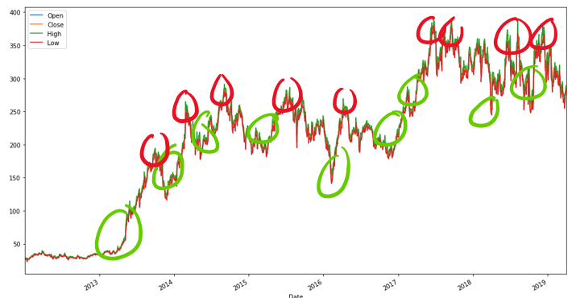
Exploratory Data Analysis

Slide 8
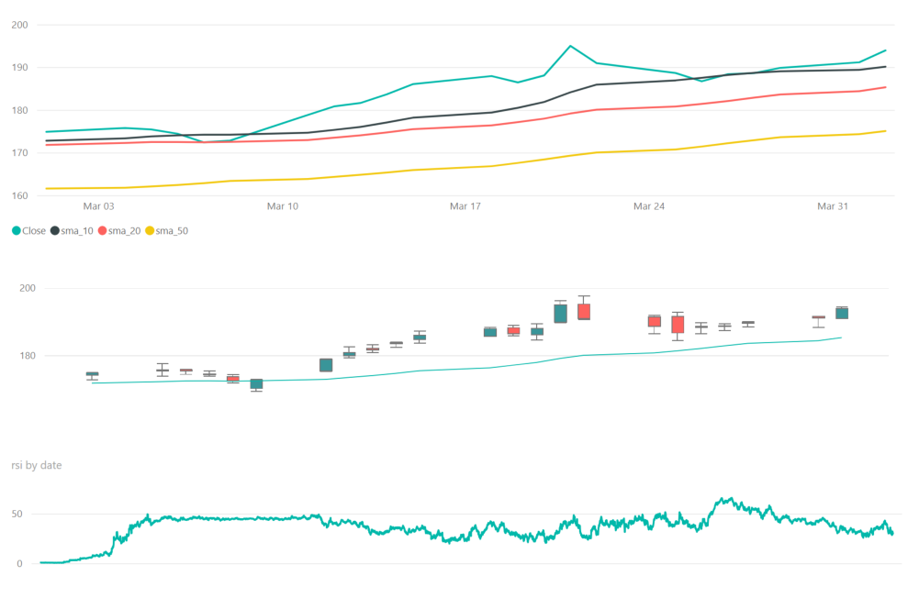
APPL Trend Analysis (March 2019)

Slide 9
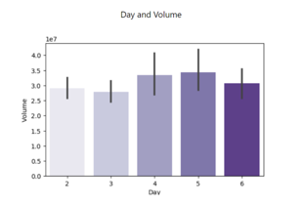
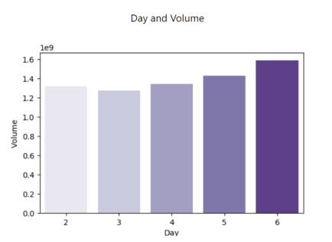
Timing the market
The bar plots of volume for AAPL demonstrates a shift in trading patterns between the 2 date periods observed (August – October) vs. (January – March) .

Slide 10
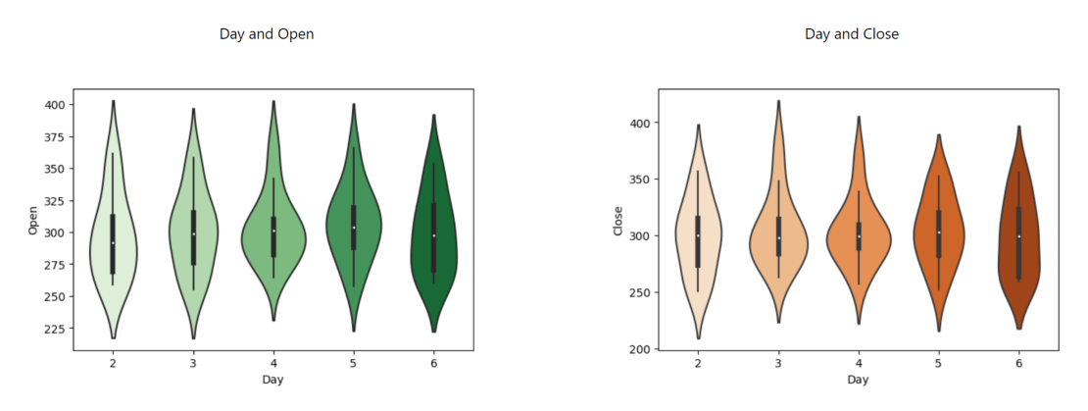
Timing the market (2)
A look at the violin plots of Open and Close prices for AAPL demonstrates a tendency to try and fail to push it’s highest trading price for the day in question.

Slide 11
Machine Learning algorithms
ARIMA
MLP
LSTM
CNN
ARIMA is a regression model, which has historically been chosen to analyze stock prices.
Auto regressive, moving average or Integrated model?
The MLP (Multi Layer Perceptron) this is conventionally the first neural network run in order to determine feasibility and investment, before more complicated networks are deployed.
Long Short Term Memory is a Recurrent Neural Network which can be used to forecast values based on historical results.
RNN designed and used primarily for image classification. This model interprets 3 dimensional matrix : width, height, depth (RGB).
A 3 dimensional tensor is what Convolutional Neural Network’s expects as input

Slide 12
ARIMA

Slide 13
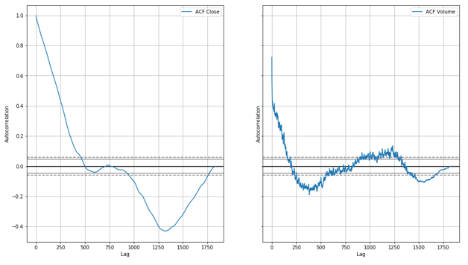
ARIMA
The Auto-correlation and Partial Auto-Correlation graphs help us to best understand the requirements for the P and Q values. ACF plots of Close and Volume are illustrated below
Notes:
The autocorrelation for an observation and an observation at a prior time step is comprised of both the direct correlation and indirect correlations
The partial autocorrelation at lag k is the correlation that results after removing the effect of any correlations due to the terms at shorter lags

Slide 14
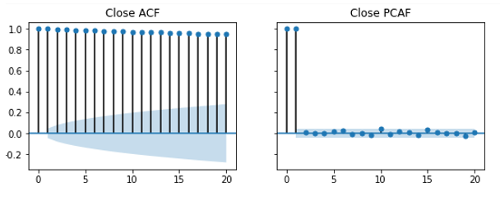
SELECTING P D and Q
The Auto-correlation and Partial Auto-Correlation graphs help us to best understand the requirements for the P and Q values. ACF plots of Close and Volume are illustrated below.
ARIMA(0,1,1) without constant = simple exponential smoothing

Slide 15
Seasonality
Augmented Dickey Fuller Test
We need to make the data stationary by scaling it correctly.
Test for stationarity and unit root with ADF Test. With a 21 and 63 day lag resulted in a p-value of 5.9 *e-08 . Indicating our data can be interpreted seasonally with a 63 day lag.
Plotting the residuals for the 63 and 21 day seasonal decomposition of this data, and the trend allows us to observe the distribution of errors about the mean, and the line smoothing interpreted from the results.

Slide 16
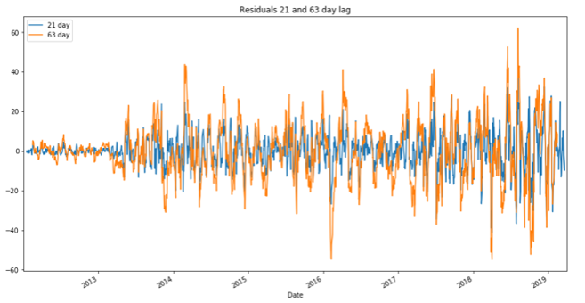
Residuals
Distribution of errors about the mean, and the line smoothing can be interpreted from plotting the results.

Slide 17
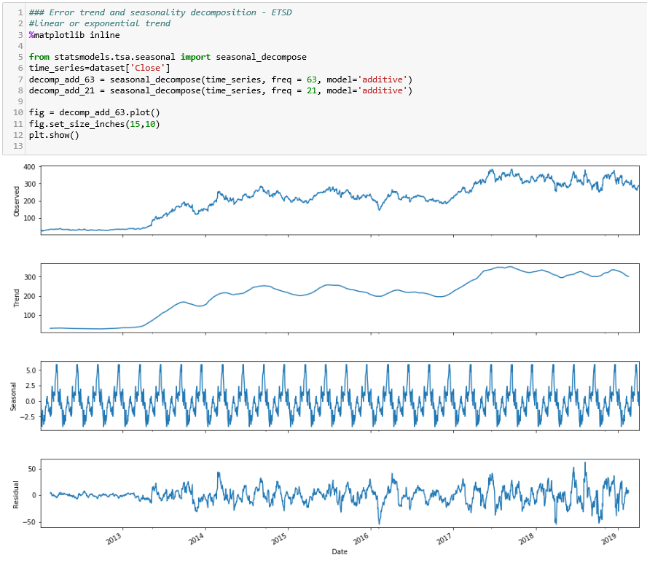
Augmented Dickey Fuller Test

Slide 18
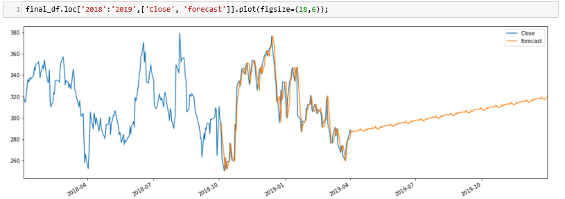
ARIMA Model
Less than impressive forecast from ARIMA model, on untrained data.

Slide 19
NEURAL NETWORKS
Multi-agent networks all operate in the same way : input * weight add a bias, activate.
The combination of these layers, and complexity of each one permit interpretation of previously unavailable, or seemingly irrelevant information.

Slide 20
NEURAL NETWORKS
Model Evaluation Test Harness
Because neural networks are created as an iteration of neural nodes, which combine to feed forward a result, the Mean Squared Error evaluation was our best option to measure the success of the chosen models

Slide 21
MLP
The MLP (Multi Layer Perceptron) this is conventionally the first neural network run in order to determine feasibility and investment, before more complicated networks are deployed.

Slide 22
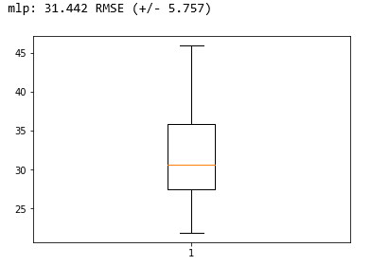
MLP Results
The final results of the MLP model were better than expected but a mean-squared-error north of 30 with another +/- 5 is not sufficient for the predictive model we seek.

Slide 23
LSTM
The LSTM neural network can be used for univariate time series forecasting, and has been leveraged in the past for this very same analysis.
In LSTM 1 weight is replaced by 3 weights
Input Gate
Forget Gate
Update Gate
Gradient is allowed to input what it needs to, forget what it doesn’t, and update as required. Sliding window across time series.
Gradient used to calculate the recurrence diminishes, and ultimately vanishes over time.
Input * weight + bias = activate
The hidden state can decide to only retrieve the short or long-term or both types of memory stored in the cell state to make the next prediction.

Slide 24
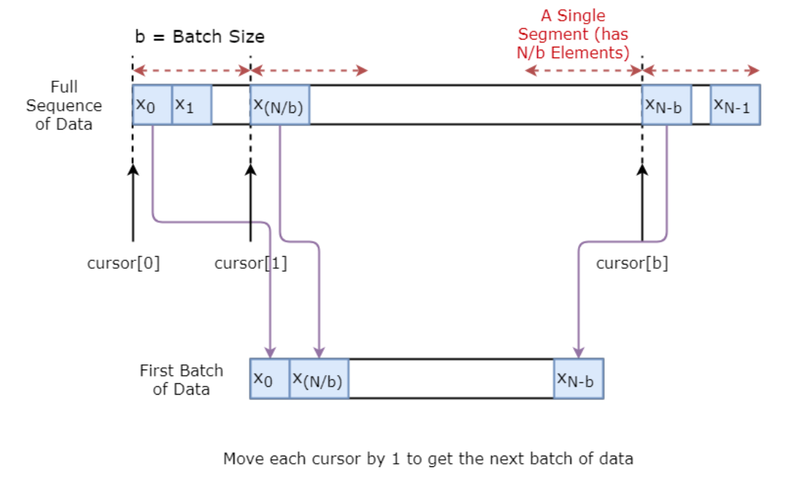
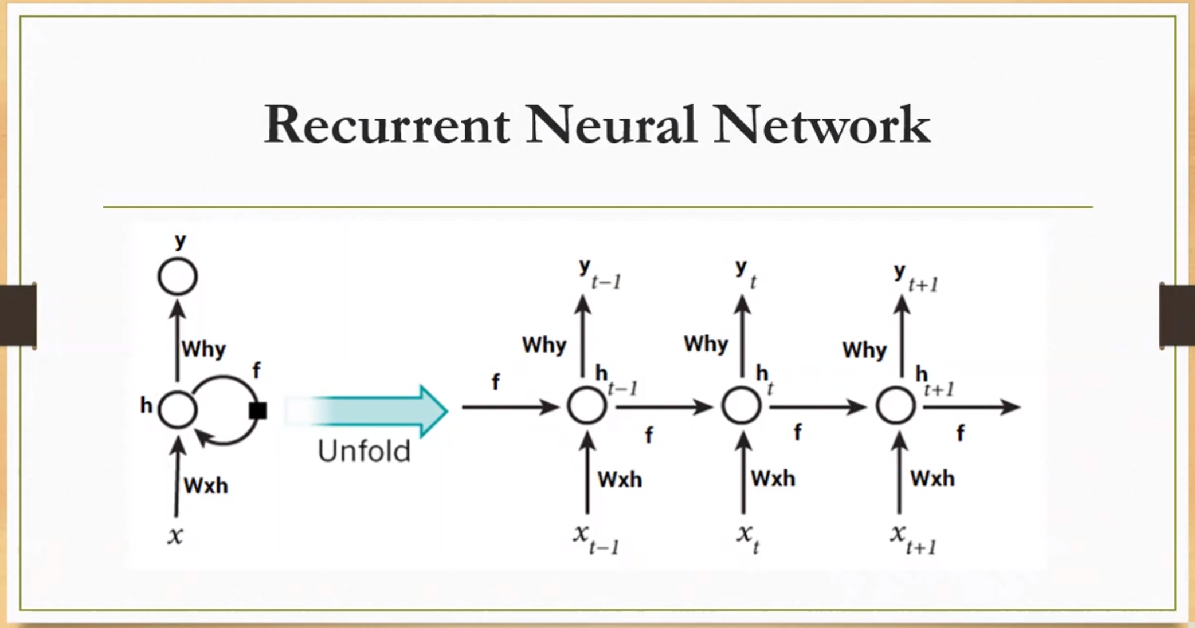
LSTM
By capturing historical information across a sliding window of time, and learning from previous iterations on the data. LSTM is better at predicting the future price of the stock than a moving average, or regressive model. Can be used for univariate time series forecasting.

Slide 25
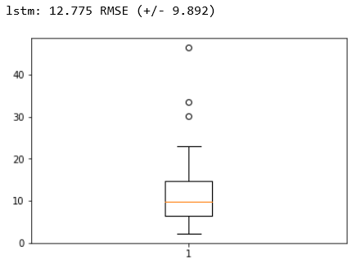
LSTM Results
Feeds forward the learned weight value, and the inputs combined through the cell learning from the previous result. The calculated RMSE for this model is lower than the Multi-layer perceptron. However the +/- ratio is much higher.
Running variants of the LSTM model have yielded far better RMSE than its most simple form. With an average MSE of 4, and certain epochs measuring at less than 0.1.

Slide 26
Convolutional Neural Network (CNN)
Traditionally used for image classification. Images fed into the model are interpreted as a 3 dimensional matrix : width, height, depth (RGB). 3 dimensional tensor is what Convolutional Neural Network’s expects as input. Series of matrix operations.
Scalar = single column
Matrix = 2 or more columns
Tensor can be both.
Convolution, Relu (y=max(0,x)) = Universal function approximator, which also eliminates the vanishing gradient in recurrent networks.
3 reasons to use Convolutional network on financial data.
Spatially invariate
Computationally less expensive than LSTM RNN
Takes into account both past, and future based on the outputs provided.
Takes feature temporal locality into consideration which is important to render decisions quickly

Slide 27
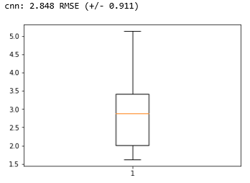
Convolutional Neural Network Results
By far, the best observed results were achieved with the Convolutional Neural Network

Slide 28
Conclusion
Can the features of a stock be leveraged to accurately predict the future value of any given stock intra-day, weekly, monthly, etc.
The features reviewed during this exercise have largely proven to be independent and unrelated to the stock price.
Can a predictive model accurately change its prediction based on intra-day price direction?
In our machine learning models we have observed, the intra-day stock price can be predicted; however the accuracy of the precision could suffer, unless the model is retrained intra-day.
Can a predictive model be trusted to make decisions to buy, hold, or sell an option at its current price, and provide a level of confidence for the trader to set their stop loss window
The models we’ve built are insufficient for a completely automated trading bot. Any decisions to buy, hold, or sell will be based on business rules, e.g. Price crossed the 20-day moving average. These decisions can be supported by a machine learning model, who’s predictions could also be tracked against the actual price.

Slide 29
Thank you
jjusteco@ryerson.ca
https://www.linkedin.com/in/felix-juste-constant/

Slide 30

Thank you
jjusteco@ryerson.ca
https://www.linkedin.com/in/felix-juste-constant/

